Slide 1
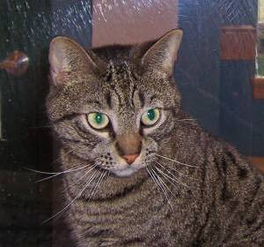
Read an image file to tensor
img = Image.open(fname)
img = Image.open(fname).resize((80, 80))
imgArray = np.array(img)
imgTensor = torch.from_numpy(np.array(img))

Slide 2
Read image files and generate input tensors
80x80x3
80x80x3
80x80x3
N files
X = [N, 80, 80, 3]

